Slide 1
Encryption & Privacy (Finance)
iQ4 Virtual Vault (Law Enforcement)
Notes:
Encryption is an important privacy tool when you are sending sensitive, confidential, or personal information across the Internet.
Encryption scrambles plain text into a type of secret code that hackers, cybercriminals, and other online snoops can't read, even if they intercept it before it reaches its intended recipients. But this can be used the other way around as the cybercriminals can use encryption to hide their communication and other important information from organizations such as the FBI, CIA.
When the message does get to its recipients, they have their own key to unscramble the information back into plain, readable text.
Encryption, then, can help protect the data you send, receive and store using a device. That can include text messages stored on your smartphone, running logs saved on your fitness watch, and banking information sent through your online account.
Encryption is designed to protect your data, but encryption can also be used against you.
Targeted ransomware is a cybercrime that can impact organizations of all sizes, including government offices. Ransomware can also target individual computer users.
How do ransomware attacks occur? Attackers deploy ransomware to encrypt the various devices, including computers and servers, of victims. The attackers often demand a ransom before they will provide a key to decrypt the encrypted data. The goal is to persuade victims to pay out as a way to recover access to their important files, data, video and images.
Ransomware attacks against government agencies can shut down services, making it hard to get a permit, obtain a marriage license, or pay a tax bill, for instance.
Ransomware attacks aimed at large organizations and government agencies tend to generate the biggest headlines.

Slide 2
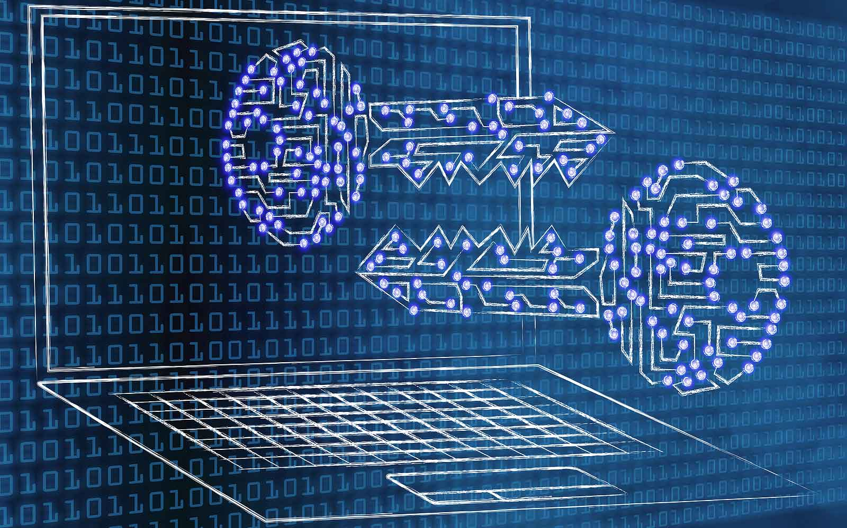
What is Encryption ?
Uses algorithms.
Converts pain text into ciphered text.
Two types: ‘Symmetric’ and ‘Asymmetric’ encryption.
‘Hashing Algorithms’ are one way encryption cannot be reversed.
Notes:
Encryption is a process that scrambles readable text so it can only be read by the person who has the secret code, or decryption key. It helps provide data security for sensitive information.
Vast amounts of personal information are managed online and stored in the cloud or on servers with an ongoing connection to the web. It’s nearly impossible to do business of any kind without your personal data ending up in an organization’s networked computer system, which is why it’s important to know how to help keep that data private. Encryption plays an essential role in this task.
Encryption takes plain text, like a text message or email, and scrambles it into an unreadable format — called “cipher text.” This helps protect the confidentiality of digital data either stored on computer systems or transmitted through a network like the Internet.
When the intended recipient accesses the message, the information is translated back to its original form. This is called decryption.
To unlock the message, both the sender and the recipient have to use a “secret” encryption key — a collection of algorithms that scramble and unscramble data back to a readable format.
An encryption key is a series of numbers used to encrypt and decrypt data. Encryption keys are created with algorithms. Each key is random and unique. There are two main types of encryption systems: symmetric encryption and asymmetric encryption. Here’s how they’re different. Symmetric encryption uses a single password to encrypt and decrypt data. Asymmetric encryption uses two keys for encryption and decryption. A public key, which is shared among users, encrypts the data. A private key, which is not shared, decrypts the data.

Slide 3
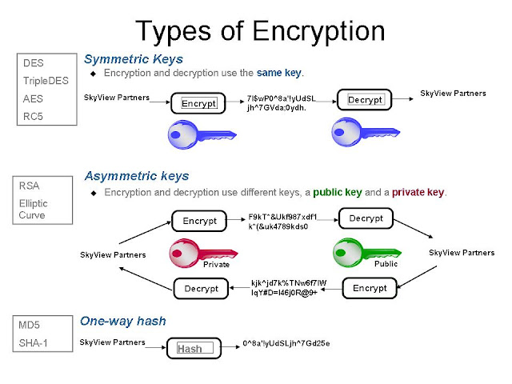
Encryption Algorithms
Data Encryption Standard (DES)
Triple DES
RSA
Advanced Encryption Standard (AES)
Two Fish
Notes:
An encryption algorithm is the set of rules, usually governing a computer or other tech device such as a smart phone, that turns readable data into scrambled cipher text. The data scrambled by these algorithms look like randomized code. But the algorithms configure this scrambled data in a purposeful way so that it can easily be turned back into a readable format by a decryption key.
There are several types of encryption, some stronger than others.
The most common examples of encryption are:
Data Encryption Standard: DES is considered a low-level encryption standard. The U.S. government established the standard in 1977. Because of advances in technology and decreases in the cost of hardware, DES is essentially obsolete for protecting sensitive data.
Triple DES: This runs DES encryption three times. It encrypts, decrypts and encrypts data — thus, “triple.” It strengthens the original DES standard, which is now viewed by security experts as being too weak for sensitive data.
RSA: This takes its name from the familial initials of three computer scientists. It uses a strong and popular algorithm for encryption. RSA is popular because of its key length and, therefore, widely used for secure data transmission.
Advanced Encryption Standard: AES is the U.S. government standard as of 2002. AES is used worldwide.
TwoFish: This is considered one of the fastest encryption algorithms and is free for anyone to use. It’s used in hardware and software.

Slide 4
Infiltrating the Dark Web
Exploiting the Dark Web to get ahead
Notes:
While what can be seen on pages of the Dark Web show only piecemeal tactics of much more complex, interdependent schemes, infiltrating these communities is essential for law enforcement agencies to gain a larger understanding to help fight international organized crime.
For example, the U.S. Cyber Command has recently acknowledged that the U.S. is taking offensive action to disrupt cybercriminal groups that have launched ransomware attacks on US companies.
Despite U.S. efforts to mitigate criminal behavior in its tracks through Dark Web monitoring, previously Russian hackers have been able to find a safe haven in Russia as local law enforcement has not always arrested cybercriminals and there were not extradition treaties within Russia so as long as the individuals remained on Russian soil.
However, based on conversations collected from the Dark Web, a segment of cybercriminals now seem to be worried that Russian authorities may be actively hunting them down. Eastern-European ransomware operators are increasingly trapped as they are no longer safe in their own country and cannot physically pick up their operations and move to another location with extradition treaty agreements now in place.

Slide 5
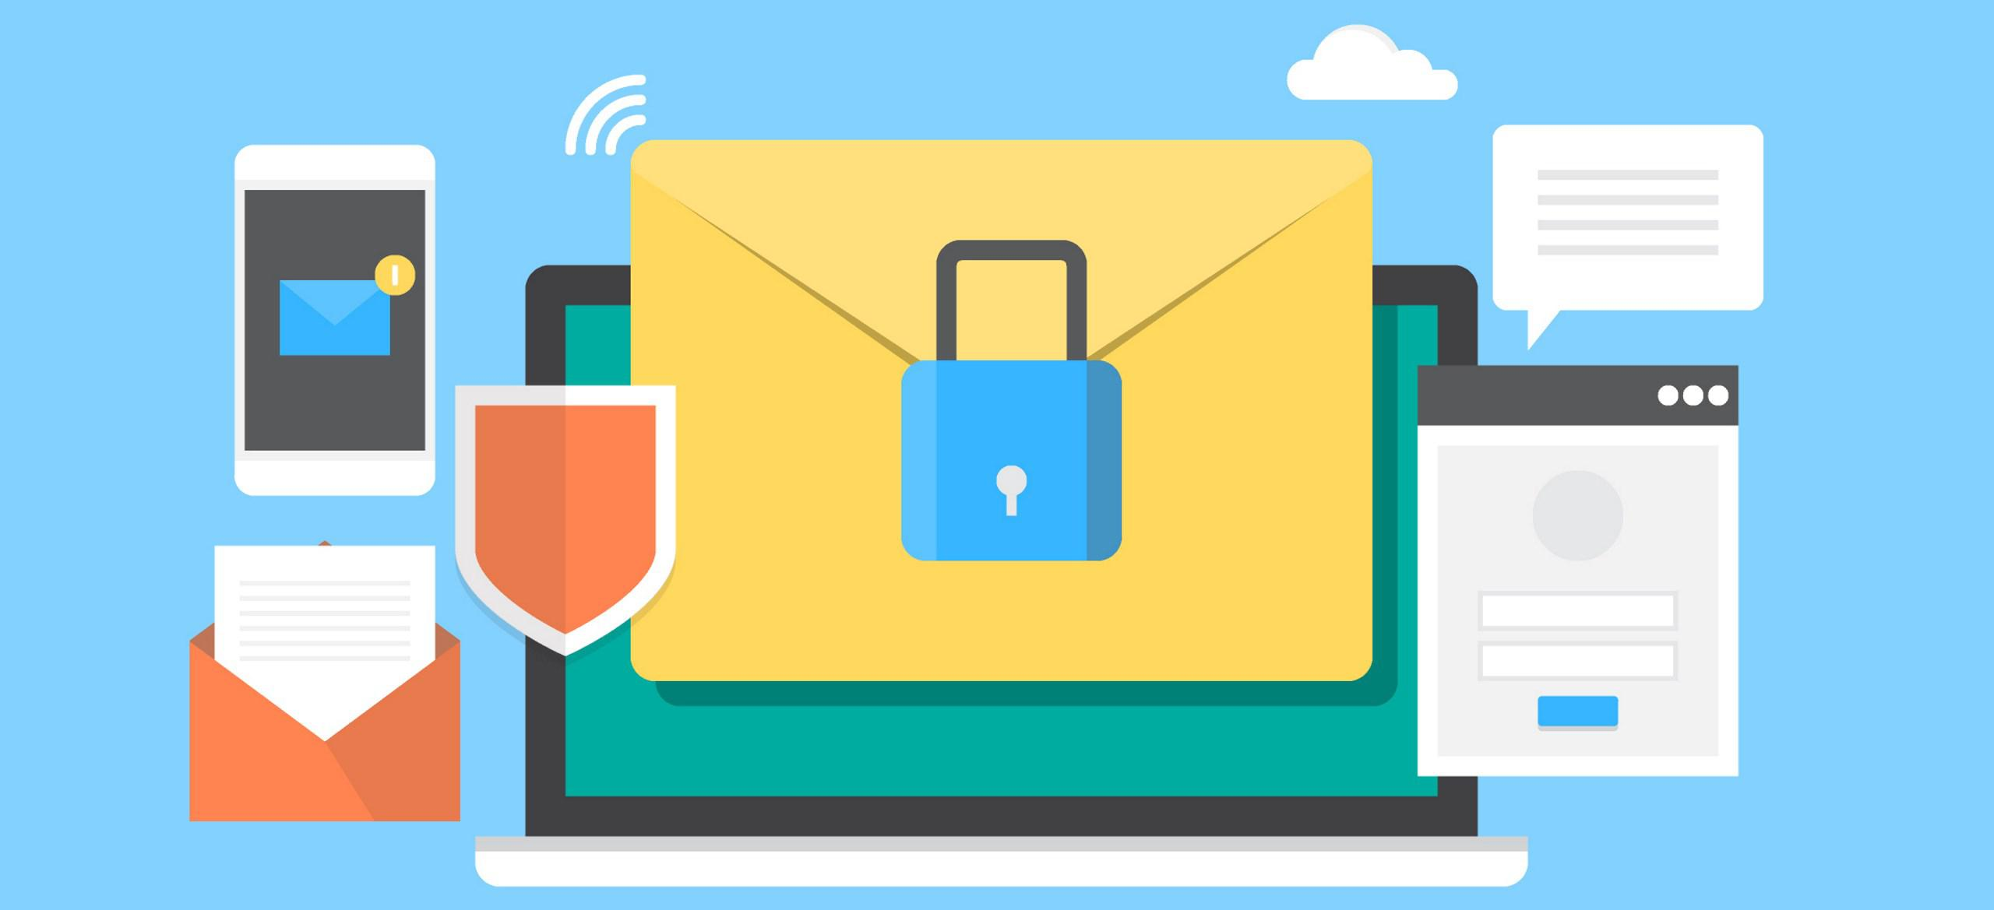
Accessing E-Mail & Messaging
End to end encryption is not widely adopted because of business reason. Most use secure socket layer (SSL) / transport layer security(TLS)
Use tools to analyze metadata
Obtain a search warrant with probable cause.
Notes:
Emails are a major part of the cybercrime communications as it is used as gateway to information, such as insights to attacks and online bank accounts.
Emails of various targeted hackers and their communities can be found on the dark web websites selling such information.
In order to obtain the data must have a warrant with probable cause
Potential risk is the ISP (Internet Service Provider) notify the user. To prevent this have the warrant prevent the ISP from notifying the user
Most email use secure socket layer(SSL) and transport layer security(TLS)

Slide 6
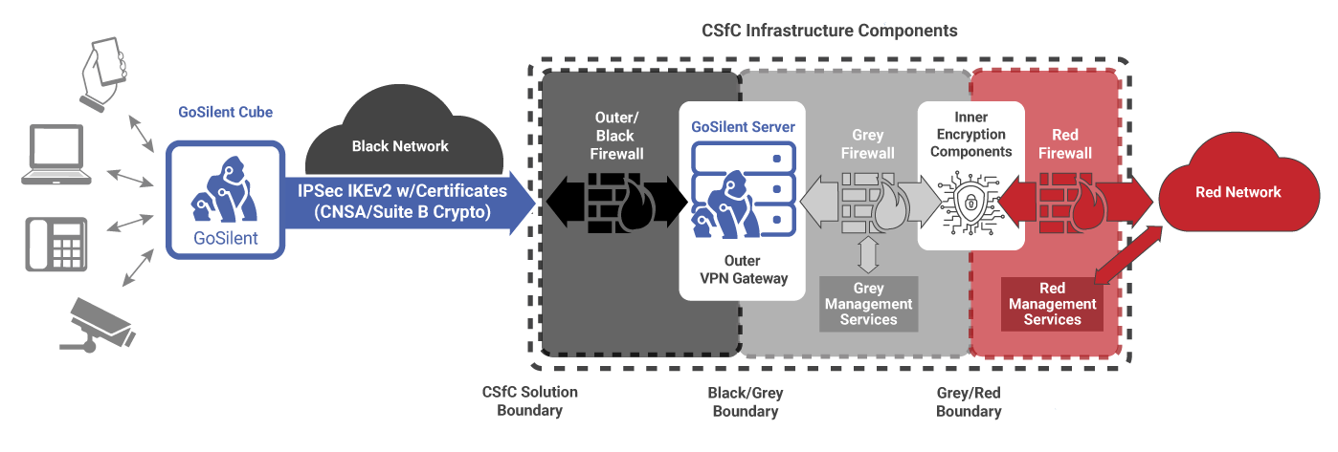
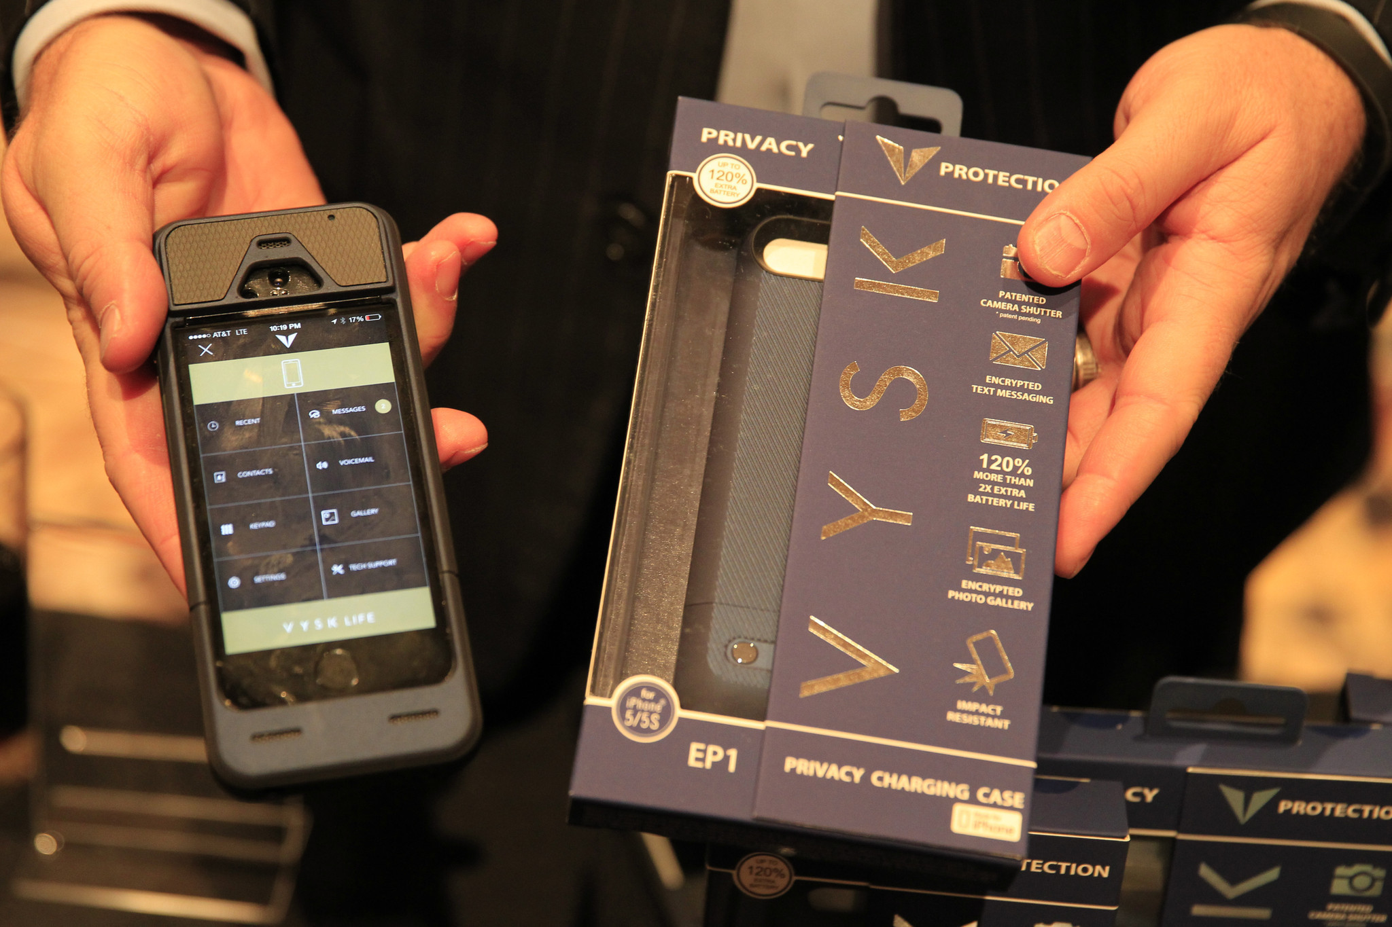
Accessing Mobile Device Communications
Tools that allow getting inside the mobile device.
Used of these tools for minor crimes
Notes:
At least 2,000 law enforcement agencies in all 50 states of the U.S. now have access to tools that allow them to get into locked or encrypted smartphones and extract data from it. There’s widespread use of mobile device forensic tools (MDFTs) by more than 2,000 law enforcement agencies. These forensic tools allow police to extract a full copy of data from a phone including emails, texts, photos, location, app data, and more, which can then be programmatically searched.
These tools are not only to investigate crimes involving major harm but also minor crimes like graffiti, shoplifting, marijuana possession, prostitution, vandalism, car crashes, parole violations, petty theft, public intoxication, and other drug-related offenses.

Slide 7
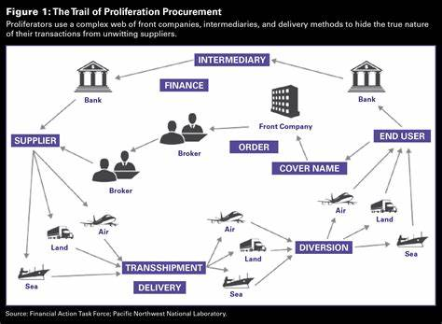
Accessing Financial Transactions
lawful access to encrypted devices
Law enforcement access encrypted content
Notes:
Once a warrant is obtained, the bill would require device manufacturers and service providers to assist law enforcement with accessing encrypted data if assistance would aid in the execution of the warrant. In addition, it allows the Attorney General to issue directives to service providers and device manufacturers to report on their ability to comply with court orders, including timelines for implementation.
Now, in order for law enforcement to access the encrypted content, it has two basic choices, compel a user to decrypt, or help decrypt, the content (e.g. disclose the password), or find a way to circumvent the encryption by attacking the crypto or the authentication mechanisms (lawful hacking).

Slide 8
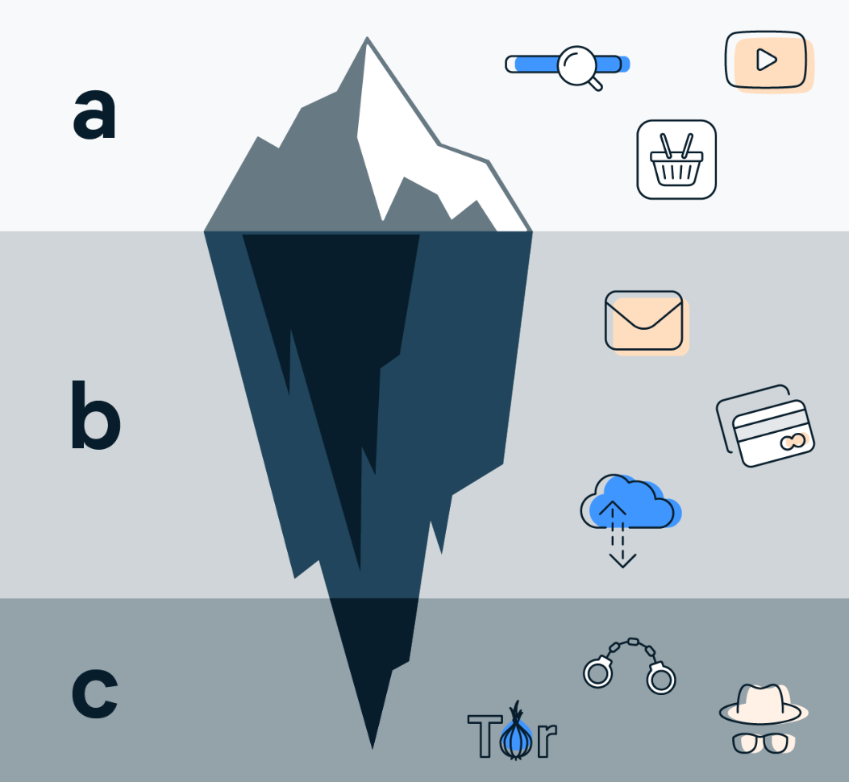
Accessing Data on Dark Web
Tool Development & Concerns
Lawful Access
Policing the shadows
Notes:
By regularly monitoring the Dark Web, security professionals can gain valuable insights into emerging trends and specific threat intelligence to improve their defensive techniques. They can leverage chatter on Dark Web forums as an early warning system, alerting them to new bots, viruses or malware that have appeared on the scene. Monitoring the Dark Web can provide early notification of an attack on a specific organization(s) too. Chatter on the Dark Web mentioning some form of access or the sale of credentials, names of executives and other information that is specific to an organization can be a giveaway you’re under attack or are being highly targeted.

Slide 9
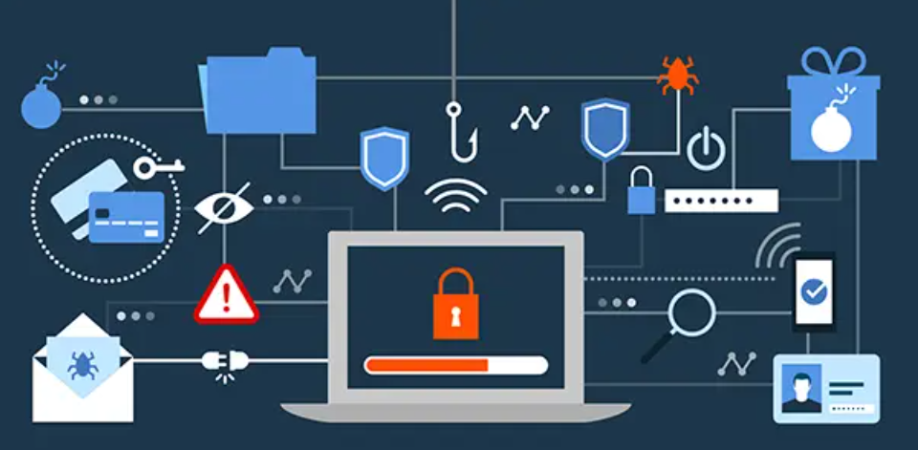
Potential Risks
How to Identify Darknet Security Risks
Safety issues accessing the dark web:
1- Criminal elements.
2- Breaking the law
3-Suspicious links
Notes:
By regularly monitoring the Dark Web, security professionals can gain valuable insights into emerging trends and specific threat intelligence to improve their defensive techniques. They can leverage chatter on Dark Web forums as an early warning system, alerting them to new bots, viruses or malware that have appeared on the scene. Monitoring the Dark Web can provide early notification of an attack on a specific organization(s) too. Chatter on the Dark Web mentioning some form of access or the sale of credentials, names of executives and other information that is specific to an organization can be a giveaway you’re under attack or are being highly targeted.

Slide 10
Sources:
DOJ OIG Releases Report on the FBI’s Strategy and Efforts to Disrupt Illegal Dark Web Activities
Safety during accessing dark web
Dark web Law enforcements

